Slide 1


وحدات معالجة مياه الصرف الصحي اللامركزية
Modular Decentralised waste water treatment
DCD-Bever
BouwCoach Engineering bv

Slide 2
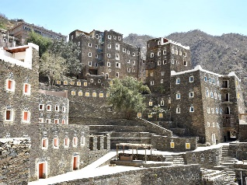


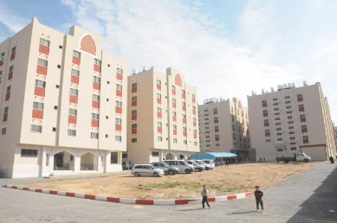
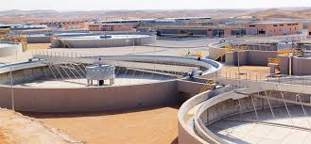


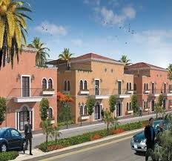
Traditional, Central Systems
A random example
Expensive piping and pumping between towns
Specific design and 3-4 years building time
Functions only when 80% is connected
Expensive piping and pumping to wwtp
Sewage to Central wwtp
Canalisation between villages
BouwCoach Engineering bv

Slide 3
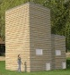
Innovative Decentral Systems
Modular design, 4 weeks building time
Closed systems: no smell
Realisation in Phases!
Modular design, transportable, expandable
Local
re-use of effluent!
No need for transport piping:
20-50% Lower Capex and Opex !
BouwCoach Engineering bv

Slide 4
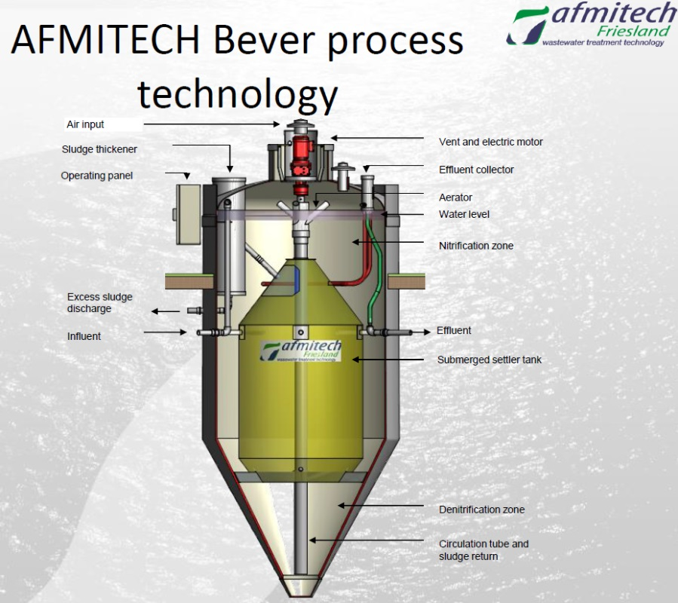
DCD-Bever
Modular biological waste water treatment plant
BouwCoach Engineering bv

Slide 5
Influent parameters for testing
Parameters | Average Value | Maximal Value | Minimal Value
BOD₅ | 308,8 | 380,0 | 259,8
COD | 783,3 | 1028,3 | 669,3
N-total | 68,8 | 79,1 | 54,8
SS | 390,9 | 615,0 | 307,5
COD : BOD | 2,6 | 3,0 | 2,0
Test results Effluent
Parameters | Average Value | Maximal Value | Minimal Value
BOD₅ | < 3,0 | < 3,0 | < 3,0
COD | 40 | 50 | 30
N-total | 10,0 | 26,8 | 2,2
NH₄+ | 0,9 | 1,9 | < 0,2
SS | 2,7 | 7,7 | < 2,0
BouwCoach Engineering bv

Slide 6
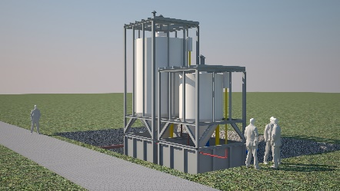
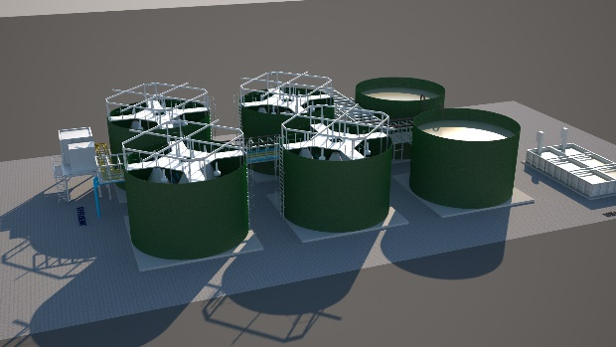
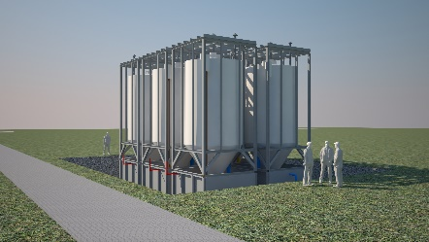
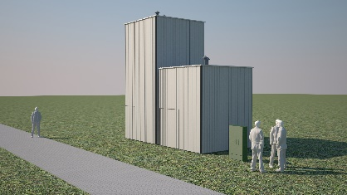
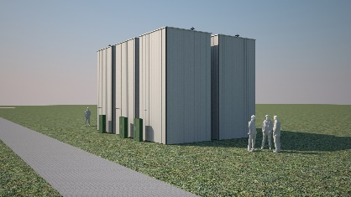
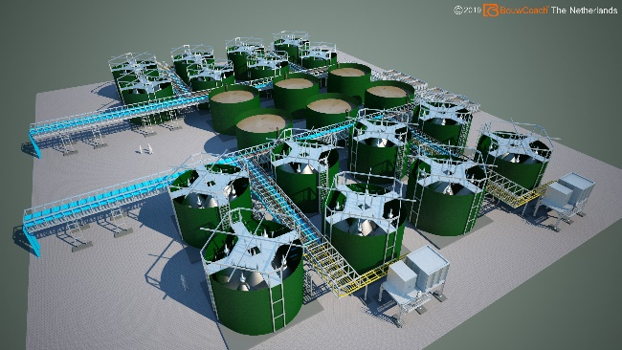
Modular Approach
The Bever-DCD system is a modular system of decentralised wastewater-treatment for communities from 50i.e., 100i.e. and 175i.e in steps up to 1400i.e.
Innovation in purification technologies develops fast. This modular approach guarantees the flexibility of (re)placing systems or system-parts at any time.
Our modular systems can be expanded at any time with the newest technology.
Decentral Modular Units!
Central Modular Units also available!
1750ie up to 50.000ie or more!
BouwCoach Engineering bv

Slide 7
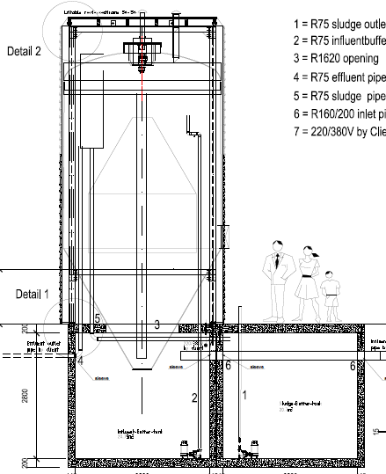
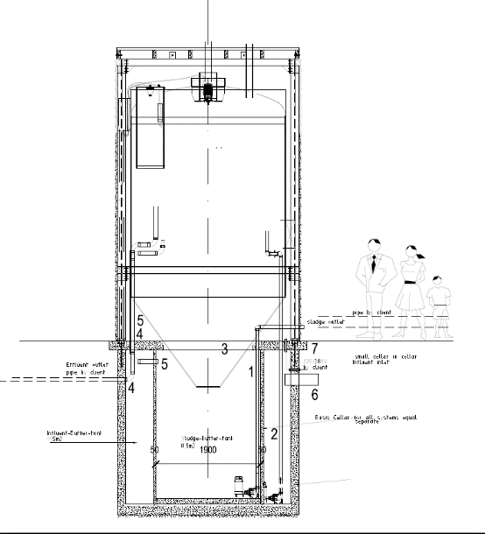
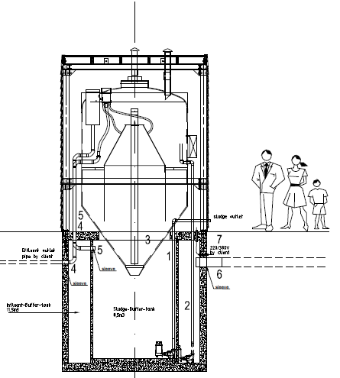
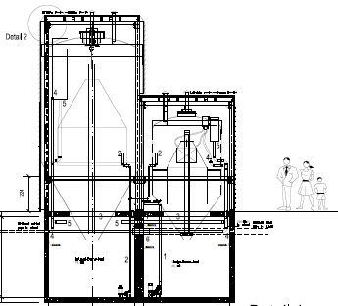
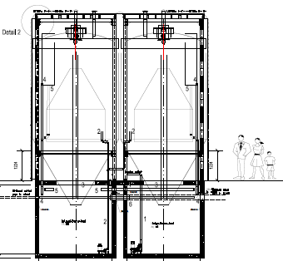
Modular basic systems:
175 i.e.
50 i.e.
100 i.e.
350 i.e.
225 i.e.
BouwCoach Engineering bv

Slide 8
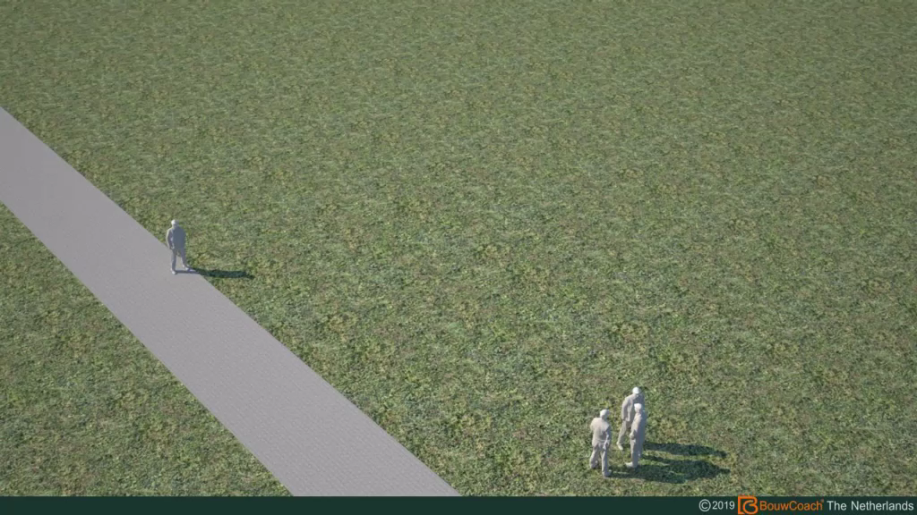
BouwCoach Engineering bv

Slide 9
Modular Additionals:
UV-Desinfection!
Automatic Bar-Screen and Pit!
Mobile dewatering unit!
BouwCoach Engineering bv

Slide 10

Modular small Units from 50ie to 1400ie
Easy to expand, reduce or replace capacity
Transportable Units
Saving costs for connecting sewage-piping
Saving costs and time for design: It’s prefabricated!
Low maintenance costs – Telemetric monitoring
Easy to Install: It’s Plug&Play
Temperature controlled between 7 and 27 grC
Low energy consumption by patented Areation
Operating margins -60 to +40% of design capacity
Closed tanks: Almost no smell nuisance
Effluent re-use in (for example) irrigation
Proven Technology – Dutch Quality
BouwCoach Engineering bv

Slide 11
شكرا على الاهتمام
BouwCoach Engineering bv

